Slide 1
A Review of the 2014 Gulf of Mexico Wave Glider® Field Program
Pat Fitzpatrick, Yee Lau, Robert Moorhead, Adam Skarke
Mississippi State University
Daniel Merritt, Keith Kreider, Chris Brown, Ryan Carlon, Graham Hine, Teri Lampoudi
Liquid Robotics, Inc.
Alan Leonardi
NOAA/OAR/ Ocean Exploration and Research
Funded by the Sandy Supplemental Internal Competition for Instruments and Observing Systems
under NOAA Grant NA14OAR4830128

Slide 2
Background
Evolved from a private initiative to study Humpback Whale songs in 2003-2007 to maritime monitoring (for weekly to seasonal periods)
Field programs for:
  Algal blooms
  Satellite ground truth
  Mammals and fisheries surveillance
  Carbon cycle studies
  Geodosy
  Magnetics
  Hydrocarbon mapping
  Oceanography and meteorology data, including tropical cyclones
24-h operating center, with an operational GUI known as the Wave Glider Management System (WGMS). Local boat traffic monitored with AIS.

Slide 3
Instrumentation
Payloads are on the float and the glider 6 m below
Possible instruments (red used in GOM field program):
  Meteorology – wind, temperature, pressure (1-m height)
  Directional wave sensor - sig wave height, avg period, peak period, peak direction, spectra
  ADCP – profile of ocean currents
  CTD-DO (conductivity/salinity, temperature, depth, dissolved oxygen)
  Acoustic modems and acoustic recorders
  Bathymetry sensors
  Fluorometer (oil, turbidity, chlorophyll)
  Magnetometer
  Cameras
Some data transmitted real-time by Iridium satellite link, some archived onboard and retrieved after missions. Data transmission depends on a balance of priorities, power, data resolution, data types, and transmission limits.
All plots in this presentation show real-time data for the Gulf of Mexico field program
Notes:
For example, full wave spectra data and raw ADCP data is recorded for more in-depth and higher resolution post-processing.

Slide 4
Previous O&M field programs
Pacific Crossing (PacX) project with 4 WGs, including one in cat 3 TC Freda (2012). Documented by Lenain and Melville (2014) in Oct. issue J. Atmos. Oceanic Technol.
Salinity Processes in the Upper Ocean Regional Study (SPURS)
Robotic Exploration of Ocean Fronts
Other private enterprise, NDBC, and University of Southern Mississippi ventures
WGs have traversed 16 TCs, including Isaac (2012), Sandy (2012), and cat 5 Supertyphoon Rammasun (2014)
Youtube video in Hurricane Isselle (2014) at https://www.youtube.com/watch?v=e5RhkjzYbCU&feature=youtu.be

Slide 5
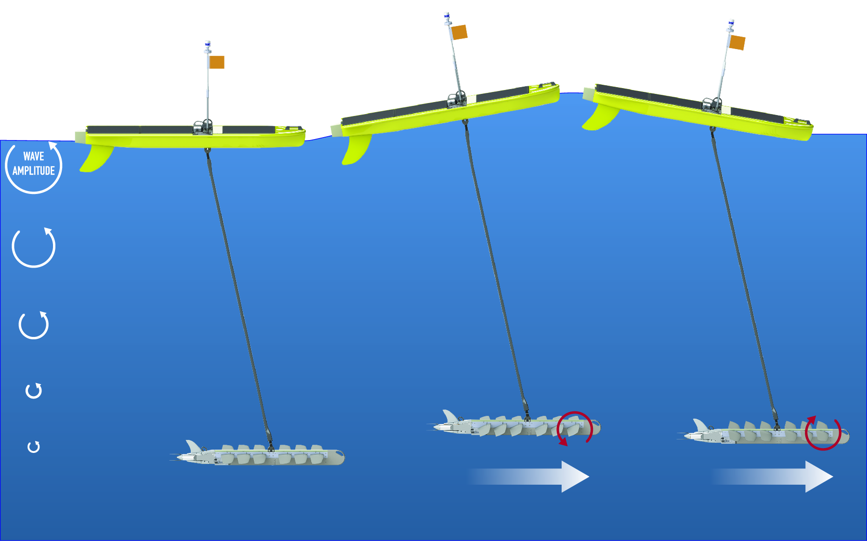
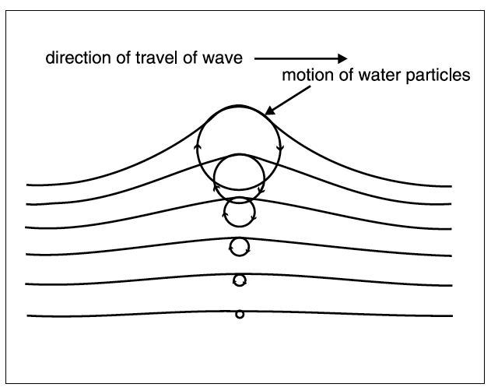
Propulsion mechanism
The propulsion works off of the buoyancy of a surface float tethered to a wing rack, the smaller amplitude of the
wave motion 6 m below, and a switch on the wings from the wave crests rising and falling. The up and down motion
of the wing system creates propulsion, pulling the float by its tether, in a synergistic feedback.
Typical translation speed range was 0.25-1 ms⁻¹, with an average of 0.5 ms⁻¹ . Proportional to buoyancy force,
generally faster for higher waves. Propulsion of 0.25 ms⁻¹ happens even with low-wind “ripples”, but drifting can occur if calm.
Also need to consider and monitor currents, because forward motion can be challenging around currents faster than 1 ms⁻¹
Notes:
Use wave energy for propulsion through the synergistic alternating thrust of wave action on the floating vehicle and mechanical wings 6 m below the vehicle
The fins installed on the glider convert the orbital motion of the wave into a horizontal force

Slide 6
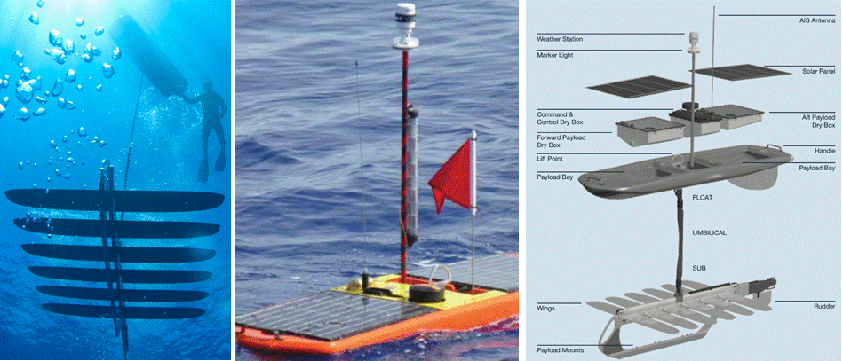
Wave Glider SV2
Notes:
All power for SV2 sensors, core communications and the navigation systems come from batteries re-charged via solar panels (80W collection rate, 40W peak power).
In addition to near real-time data delivery, full resolution data is archived onboard the WG’s sensor management computer using solid-state memory for post-deployment download. For example, full wave spectra data and raw ADCP data is recorded for more in-depth and higher resolution post-processing.

Slide 7
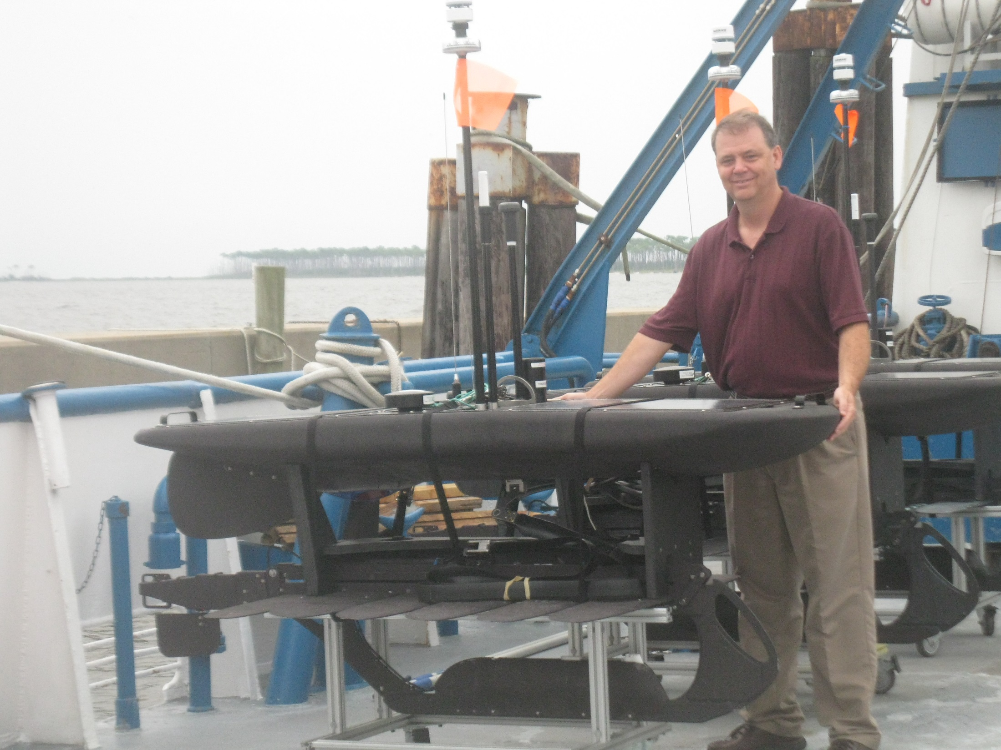
One of three WGs on R/V Tommy Munro
Pre-deployment, Biloxi, MS
Aug. 25, 2014
Launched 37 km offshore

Slide 8
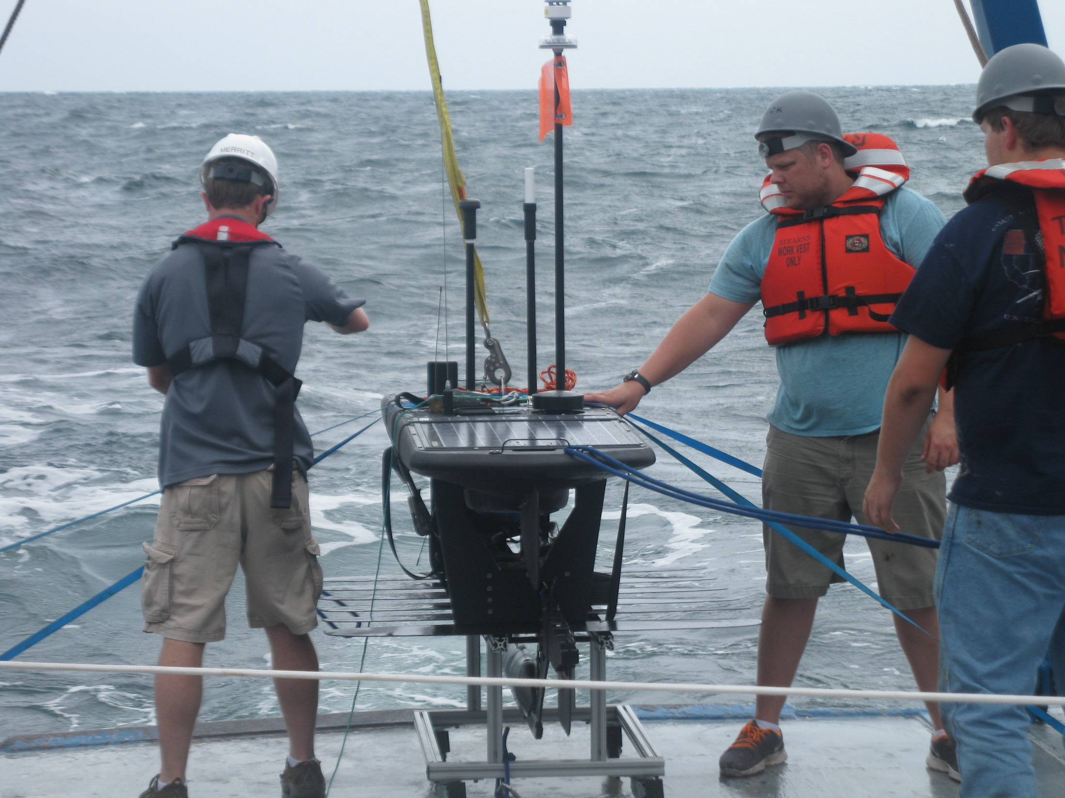
A WG about to be launched

Slide 9
Research goal
Primary goal - Intercept of Gulf of Mexico tropical cyclone by one or more WGs in 2014
Other goals –
  Validation of instruments by loitering around buoys
  Proof of concept for providing data in regions lacking buoys
  Understanding maneuverability capabilities and limitations
No tropical cyclones in Gulf of Mexico in 2014, but demonstrated maneuverability and pre-deployment capabilities on northern fringe of Tropical Storm Hanna when it formed in Caribbean Sea

Slide 10
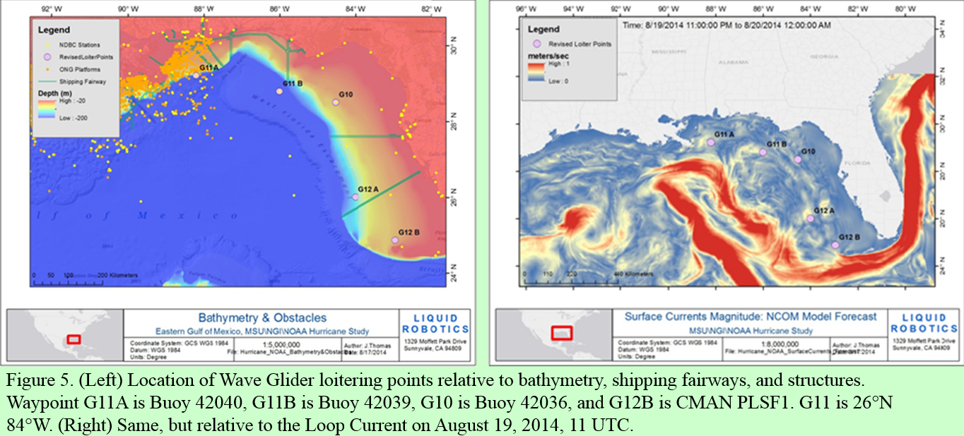
Initial plan and loitering waypoints
Must consider currents, oil rig locations, shipping lanes, political boundaries, model guidance, and tropical cyclone climatology. The team agreed to an eastern Gulf of Mexico surveillance with a spread of WGs off N. Gulf (G11), off Tampa (G10), and off SW FL (G12)
Notes:
Planning the mission must take into consideration strong currents, sea state, oil rig locations, shipping lanes, political boundaries, ocean forecasts, weather forecasts, tropical cyclone climatology, and WG speed. The team agreed to an eastern GOM surveillance because forward motion can be challenging against currents stronger than 1 ms⁻¹ for the SV2 platform in the central GOM Loop Current region, there were traffic considerations for oil rig/shipping activity, it is an entrance region for tropical cyclones, and climatology favored tropical cyclone tracks in that area.

Slide 11
Initial loitering plan
G10 targeted buoy 42036 (offshore Tampa), with stops at 42040 and 42039
G11 targeted buoy 42039 and 42040 (N. Gulf)
G12 targeted data void region around non-functioning buoys 42034 and 42003 (SW FL)
Modifications to loitering plan during mission
Sabotage or “accidental intercept” occurred to G11 twice around Buoy 42040 off Mississippi River. G11 renamed G14 after first sabotage.
G14 sent to buoy 42099 (wave and SST data only) off central FL.
G10 weather instrument also damaged. Replaced
G12 air temperature sensor failed. Another WG, dubbed GOM1, was in area from unrelated mission. GOM1 replaced G12.
G14 and GOM1 moved west of Florida Keys before and during Tropical Storm Hanna
At end of mission in late Nov., G10, G14, and GOM1 all loitered around buoy 42099

Slide 12
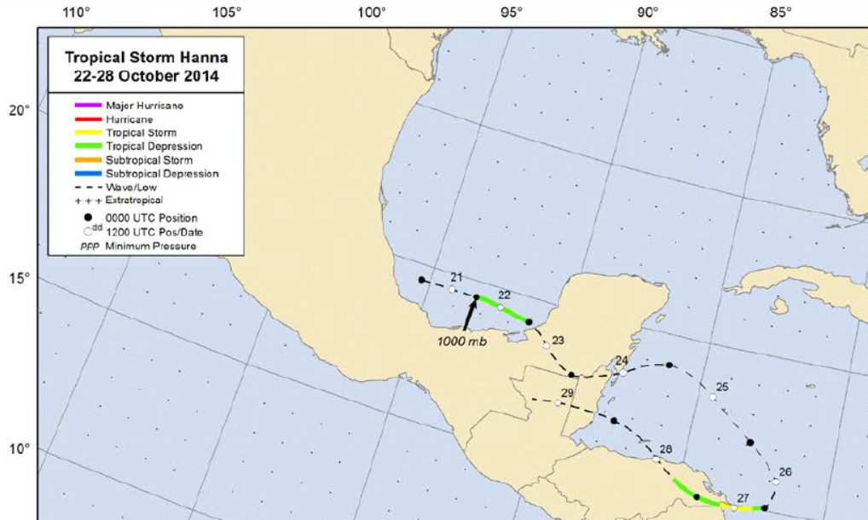
G14 loitered west of Keys 10/25-11/18
GOM1 loitered west of Keys 10/23-11/3
GOM1
G14

Slide 13
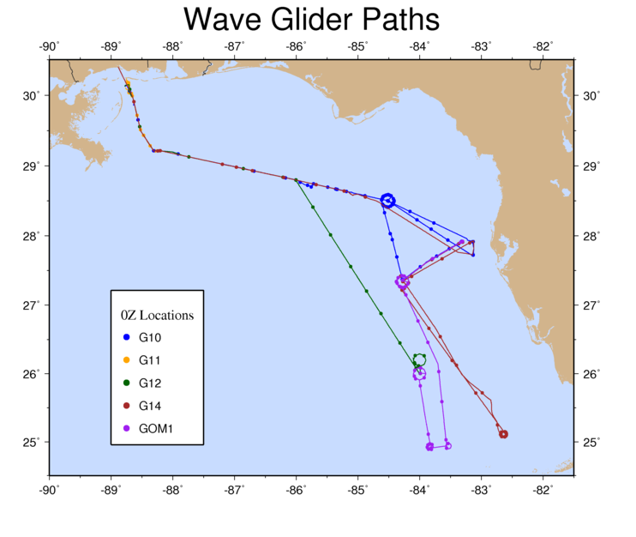
Loitering periods
G10
42040: 8/28-8/29
42039: 9/2-9/5
42036: 9/15-9/23; 10/11-11/21
42099: 11/28-11/29
G11 (renamed G14 on 9/11)
42040: 9/1-9/5
G12 (discontinued 10/24, duties assumed by GOM1)
42039: 9/1-9/2
84W, 26N: 9/9-10/23
G14
42040: 9/14-9/19
42099: 10/10-10/21
“Hanna” 82.6W 25.1N: 10/25-11/18
42099: 11/28-11/29
GOM1
84N, 26W: 10/14-10/21
“Hanna” 83.8W 24.9N: 10/23-10/31
“Hanna” 83.5W 24.9N: 11/1-11/3
42099: 11/9-11/29
Deployment 8/25/2014
42040
42039
42036
Mission ends 12/3/2014
42099
Data void, near
former 42034
and 42003
“Hanna”
“Hanna” connotes northern fringe of tropical system
Notes:
In order to meet the goals of this mission, several WG loiter zones were vetted both around existing meteorological and oceanographic buoys allowing for correlative data, as well as in data void regions. These locations were spread across the eastern GOM to increase the chances of intercepting a tropical cyclone, and initially included: buoy 42036 (28.5°N, 84.52°W); buoy 42040 (29.21°N, 88.21°W); buoy 42039 (28.79°N, 86.01°W); and a data void region (26.00°N, 84.00°W), with a possible maneuver later to 24.87°N, 82.95°W in the vicinity of CMAN PLSF1 in the Dry Tortugas.

Slide 14
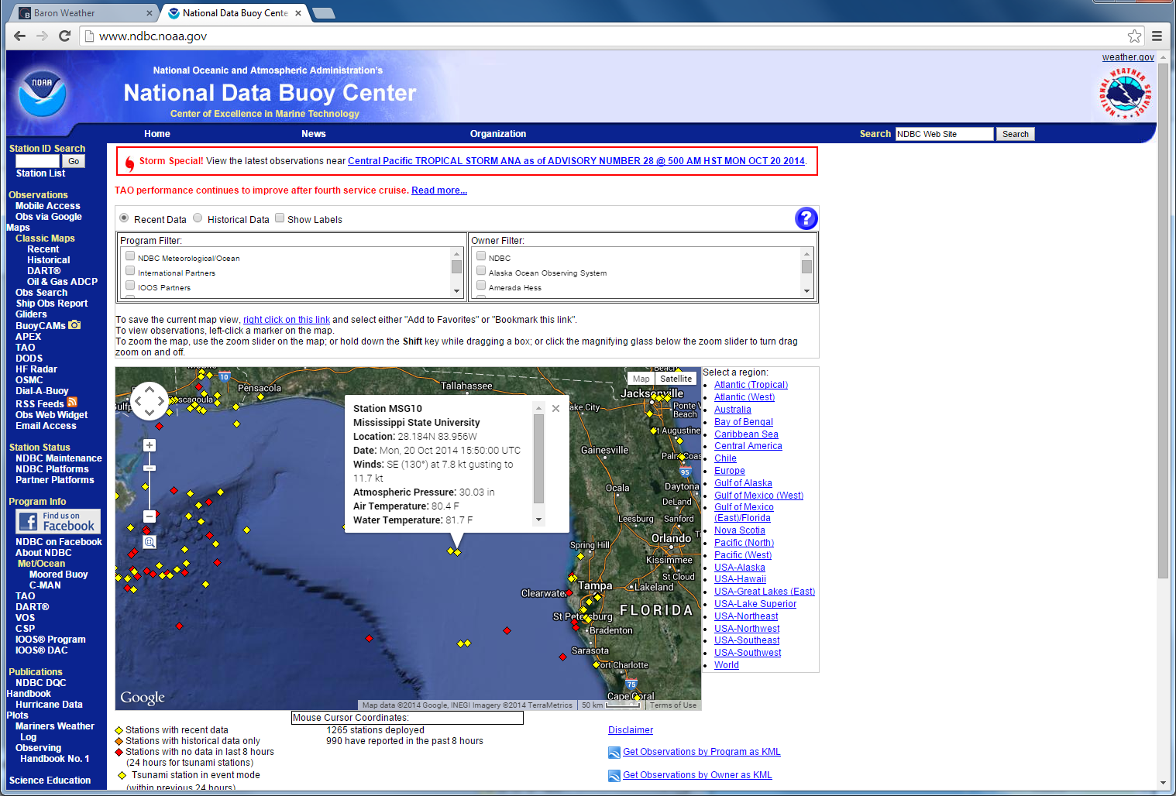
Data provided real-time from
MSU to NDBC
in WMO FM-18 format
for website display and GTS
transmission
Data also provided to GCOOS,
and setup for download
by GFDL if ever needed

Slide 15
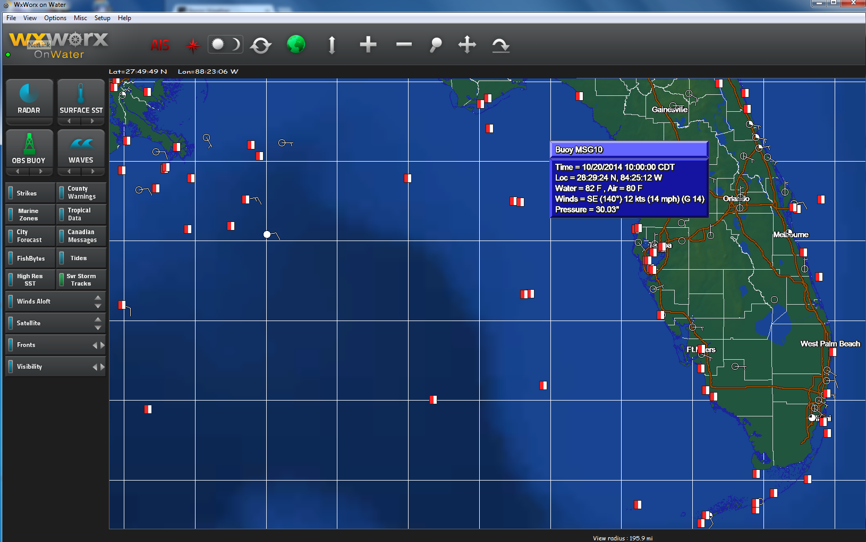
Private sector business who access
NDBC also showed the data, such
as WXWORX, Baron Weather, and
www.sea-seek.com .

Slide 16
Example data plots

Slide 17
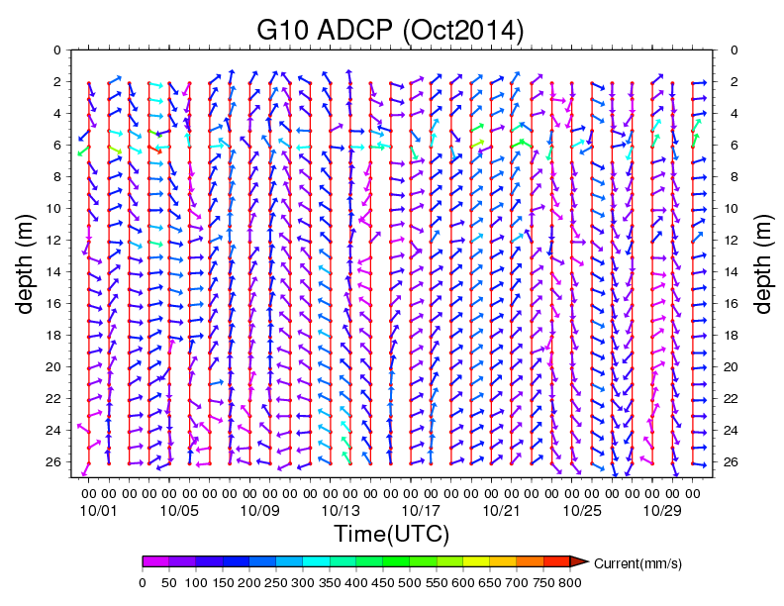
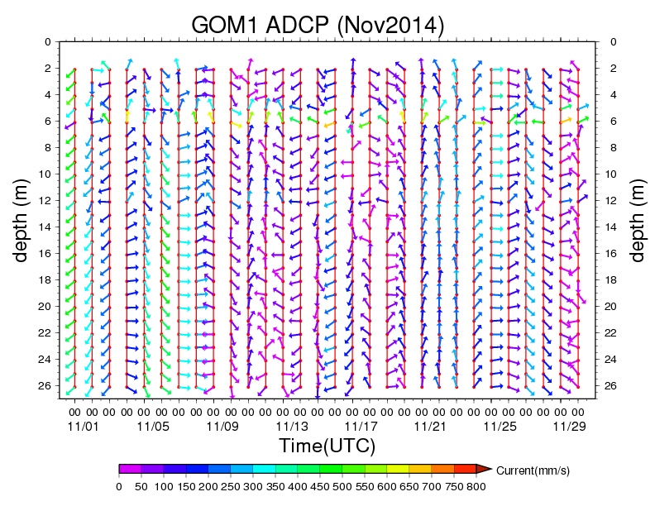
Example monthly plots of ADCP at 00Z – no validation possible
Real-time data available every 30 min

Slide 18
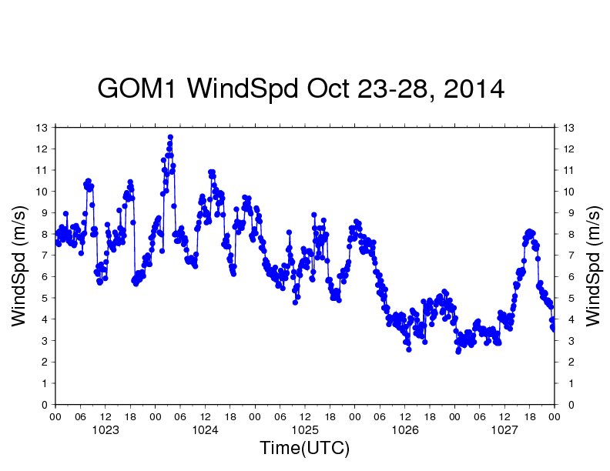
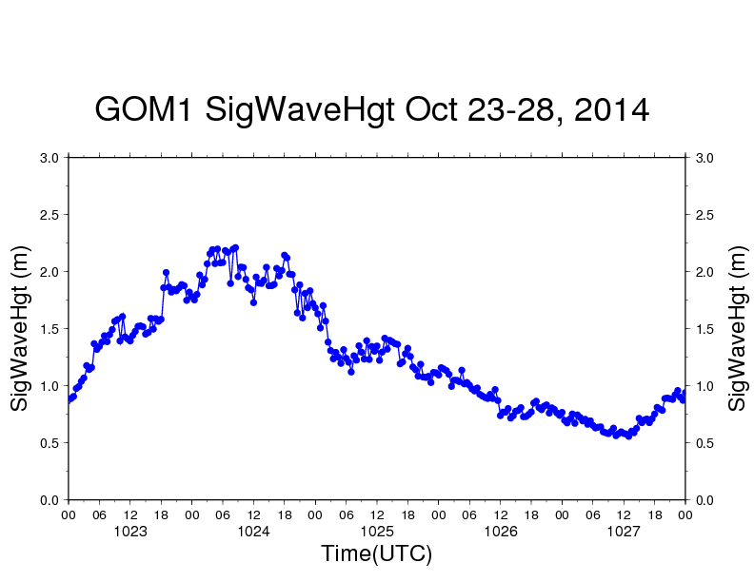
Northern fringe of Hanna lifecycle
Front and circulation interaction
Front
dissipates
Genesis
then
landfall

Slide 19
Loitering validation examples - wave data

Slide 20
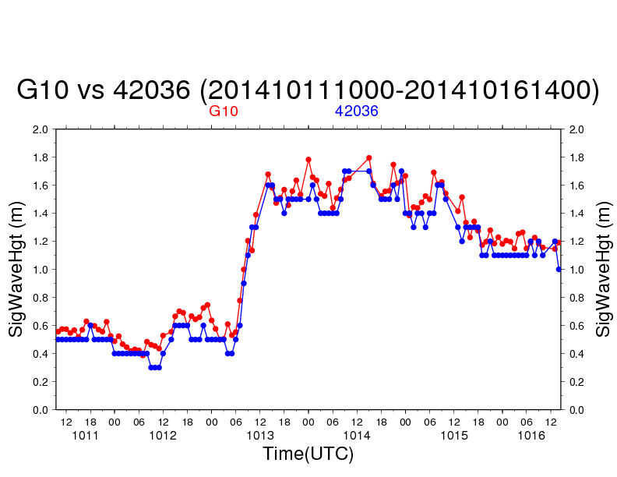
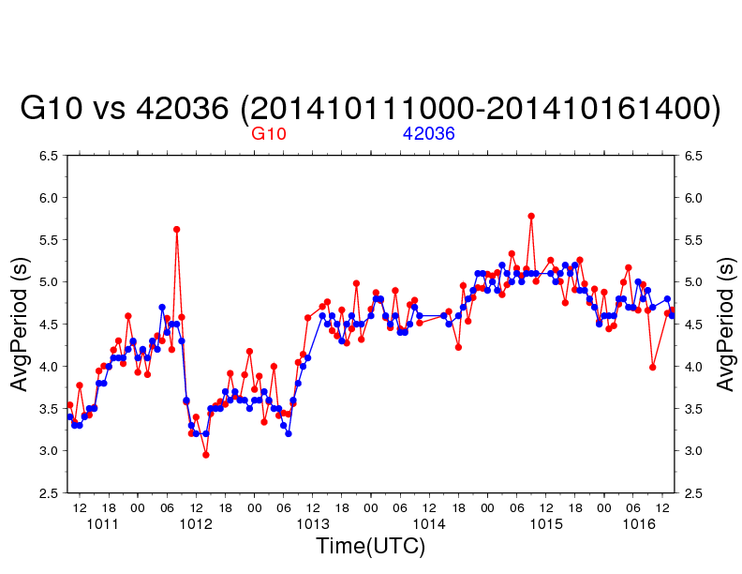
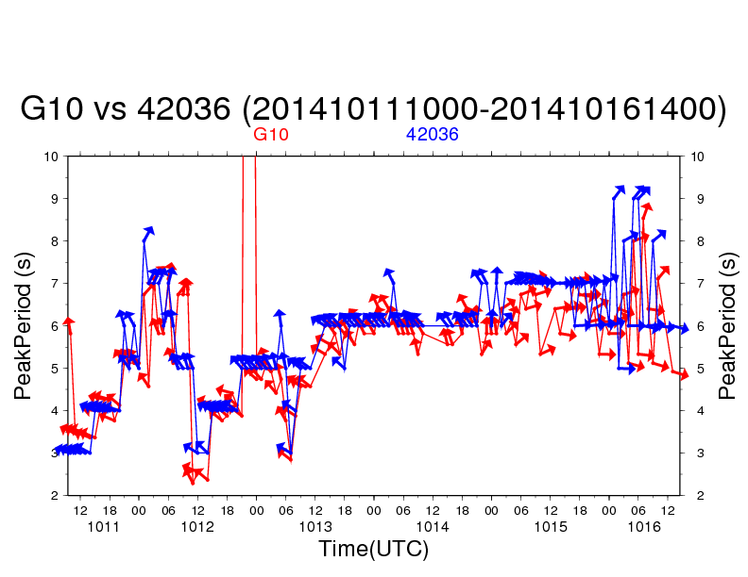
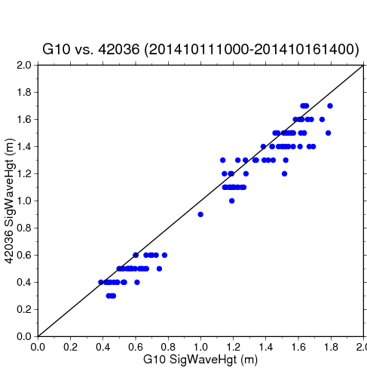
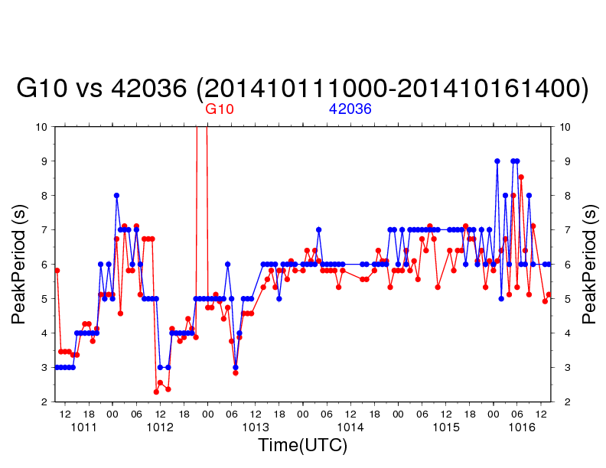
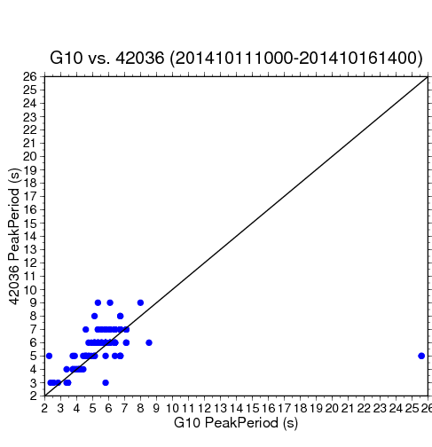
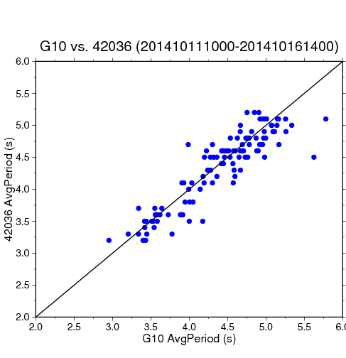
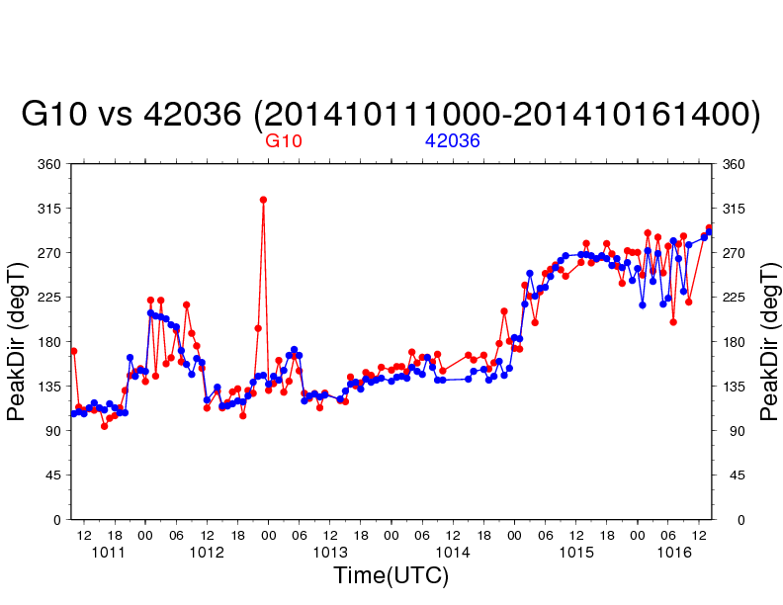
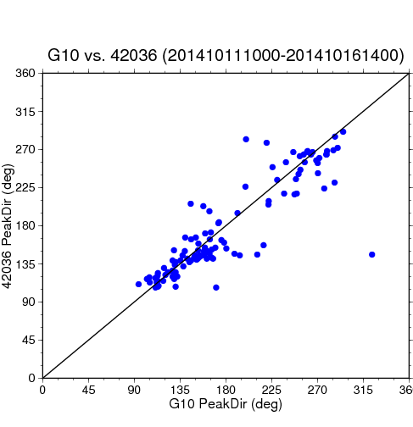
Sig Wave Hgt
Bias Err = 0.08
Abs Err = 0.09
Peak Period
Bias Err = 0.05
Abs Err = 1.06
Average Period
Bias Err = 0.05
Abs Err = 0.19
Peak Direction
Bias Err = 5.19
Abs Err = 17.27

Slide 21
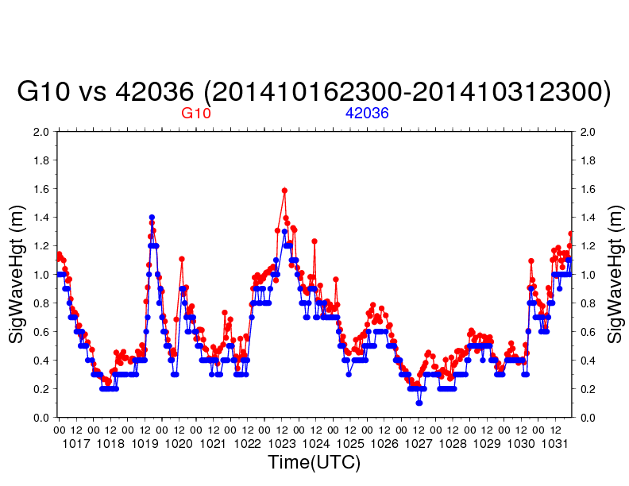
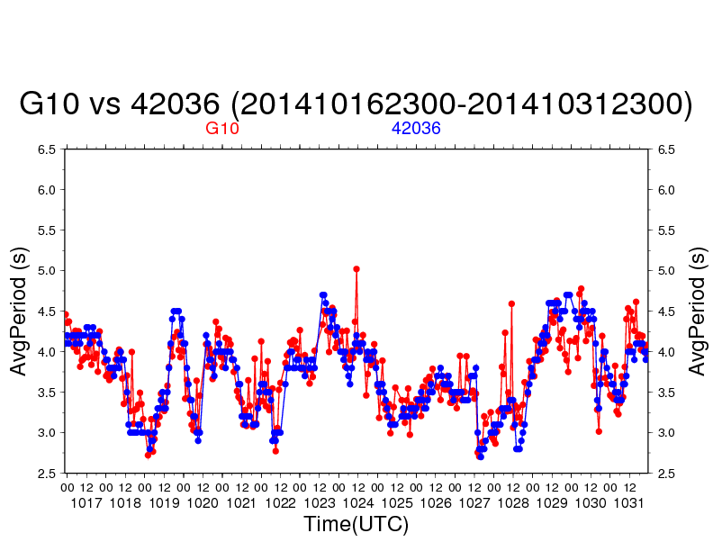
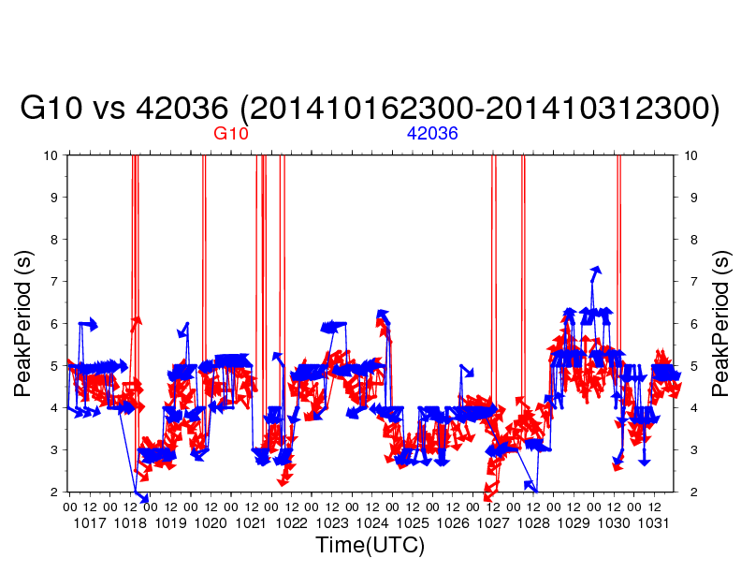
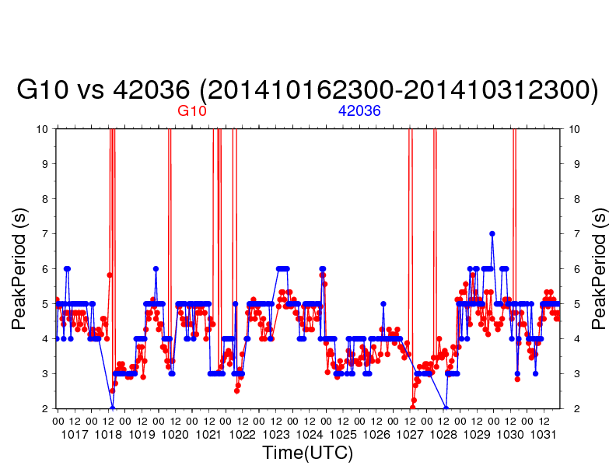
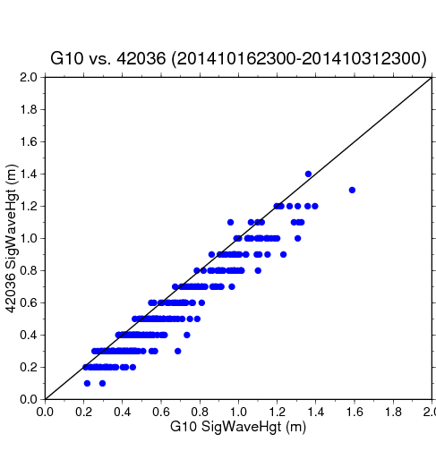
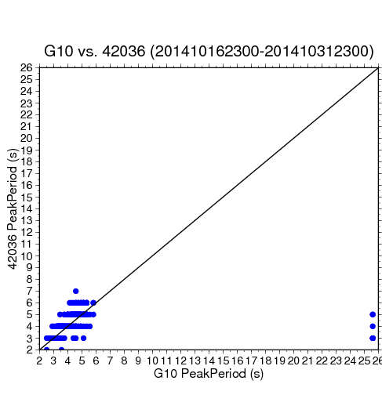
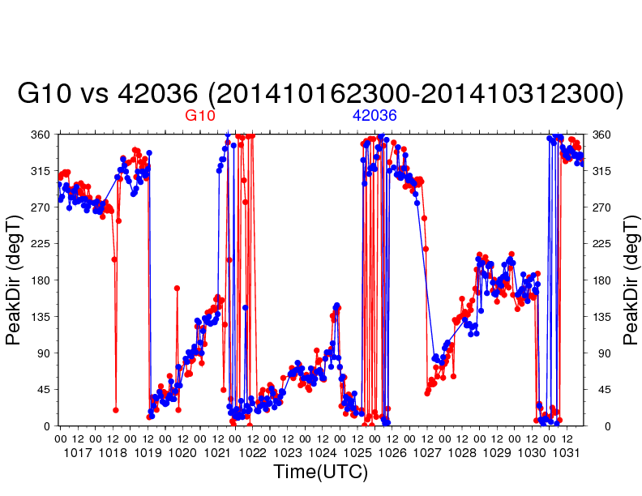
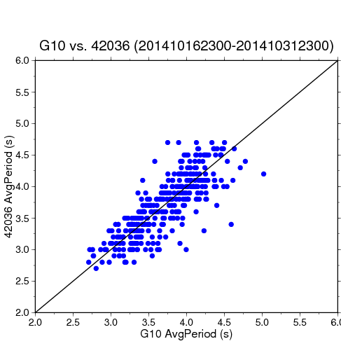
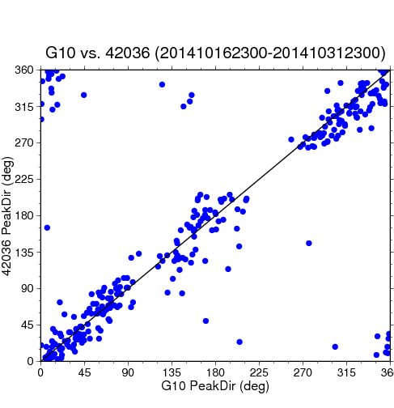
Sig Wave Hgt
Bias Err = 0.10
Abs Err = 0.10
Peak Period
Bias Err = 0.31
Abs Err = 0.99
Average Period
Bias Err = 0.01
Abs Err = 0.22
Peak Direction
Bias Err = 0.64
Abs Err = 19.20

Slide 22
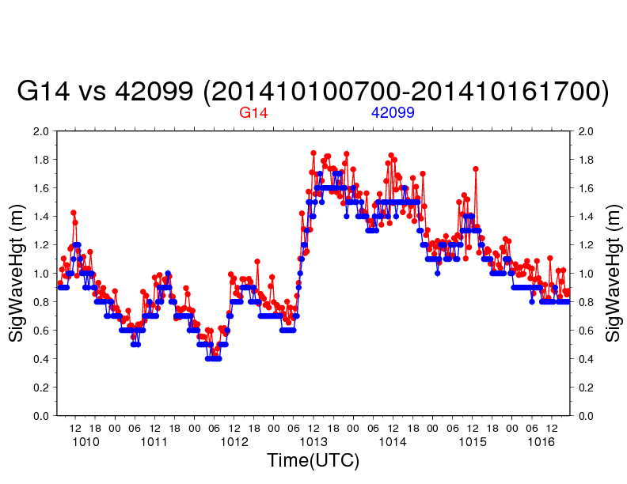
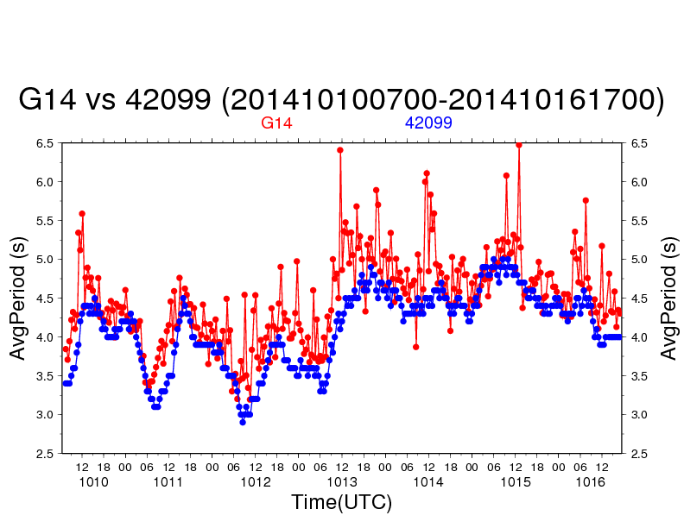
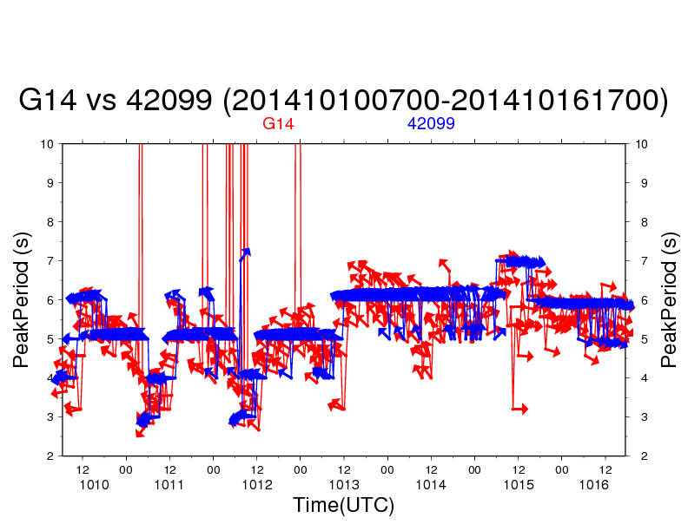
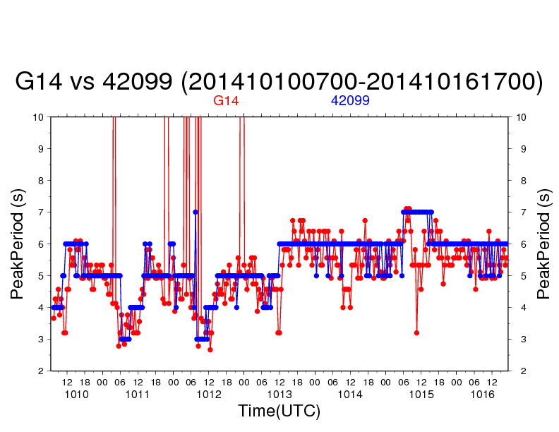
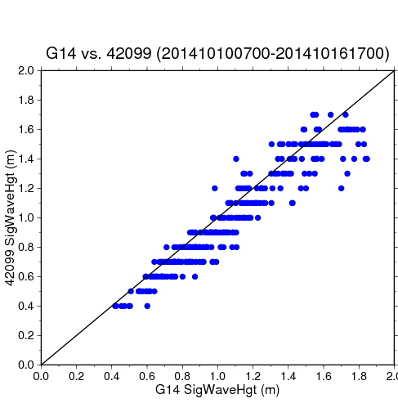
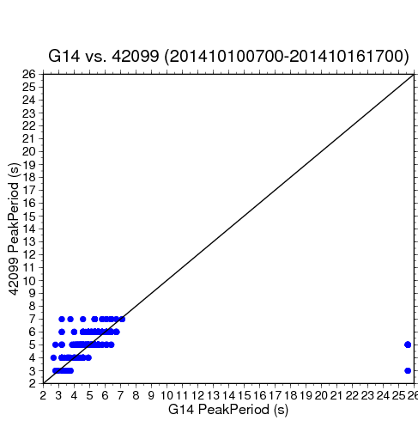
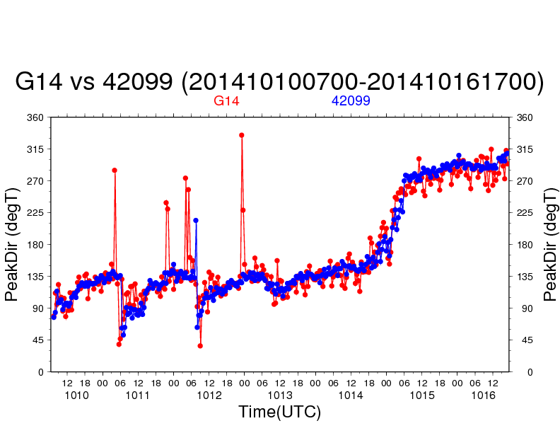
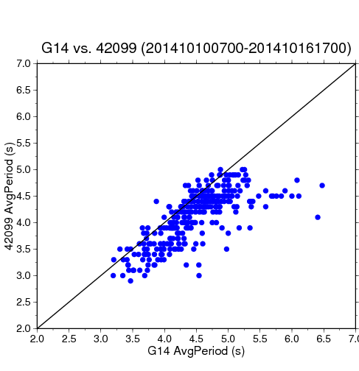
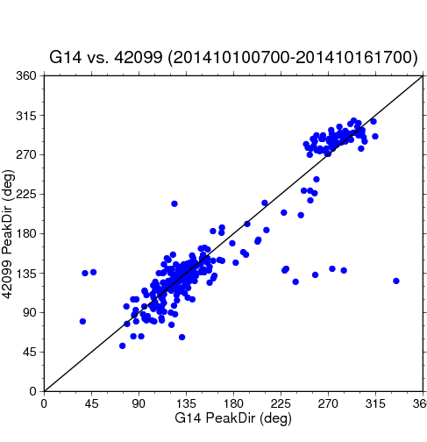
Sig Wave Hgt
Bias Err = 0.08
Abs Err = 0.10
Peak Period
Bias Err = 0.29
Abs Err = 1.21
Average Period
Bias Err = 0.36
Abs Err = 0.40
Peak Direction
Bias Err = 2.06
Abs Err = 15.17

Slide 23
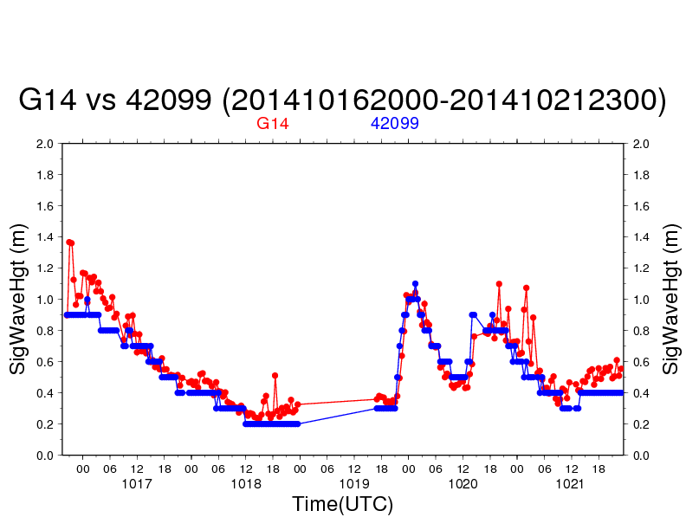
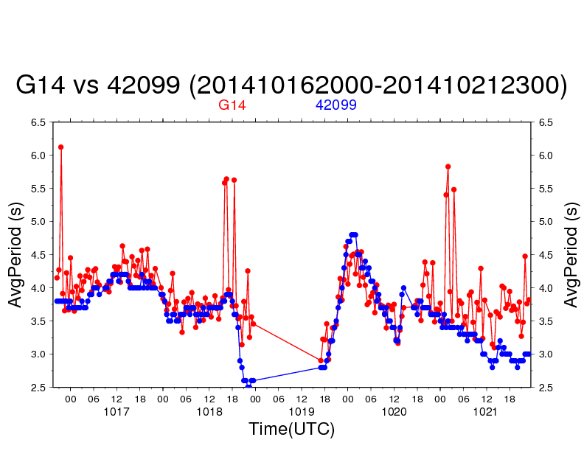
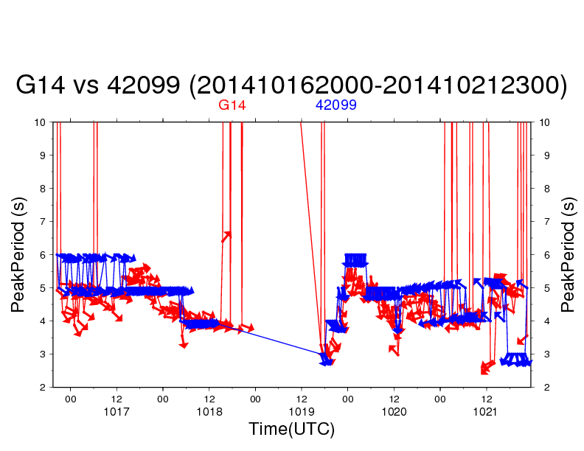
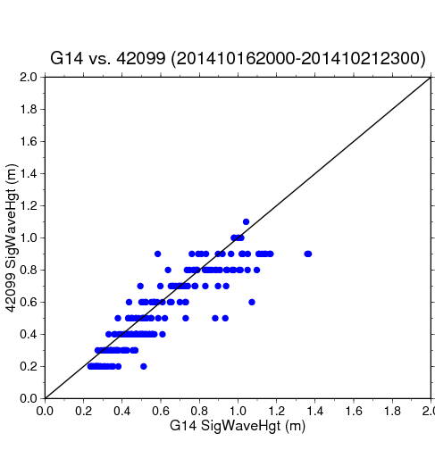

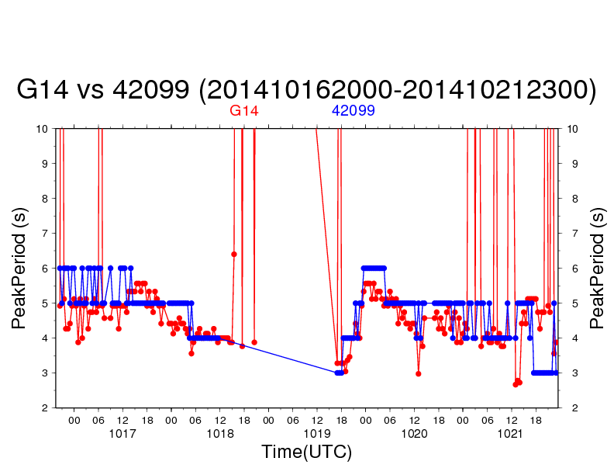
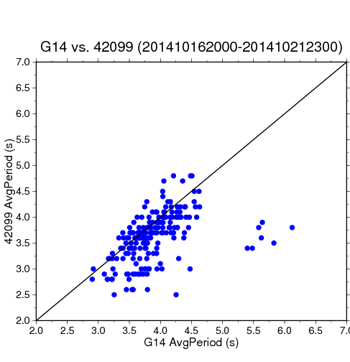
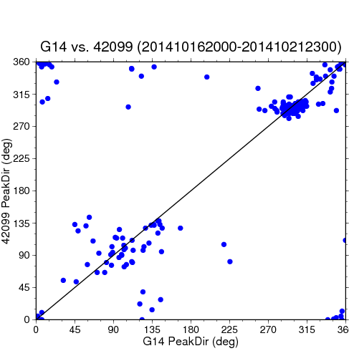
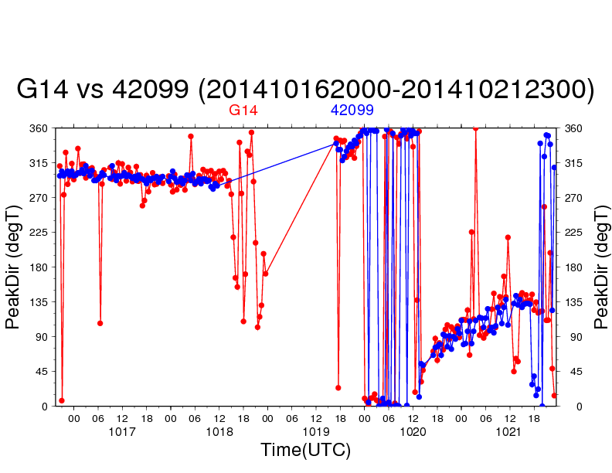
Sig Wave Hgt
Bias Err = 0.07
Abs Err = 0.10
Peak Period
Bias Err = 1.04
Abs Err = 1.90
Average Period
Bias Err = 0.28
Abs Err = 0.37
Peak Direction
Bias Err = -1.14
Abs Err = 23.24

Slide 24
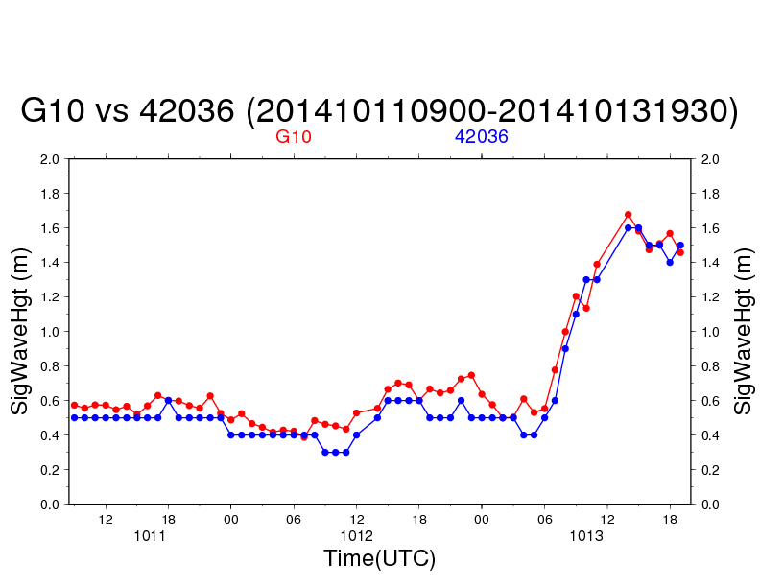








Sig Wave Hgt
Bias Err = 0.08
Abs Err = 0.09
Peak Period
Bias Err = 0.55
Abs Err = 1.37
Average Period
Bias Err = 0.10
Abs Err = 0.20
Peak Direction
Bias Err = 2.39
Abs Err = 17.59

Slide 25









Sig Wave Hgt
Bias Err = 0.08
Abs Err = 0.10
Peak Period
Bias Err = 0.87
Abs Err = 1.65
Average Period
Bias Err = 0.40
Abs Err = 0.42
Peak Direction
Bias Err = 6.79
Abs Err = 16.79

Slide 26
Loitering validation examples – meteorology data
Results preliminary

Slide 27










G10 adjusted to 4m for AirTemp and 5m for WindSpd (42036)
using 42036’s water temperature in calculation
Bias Err = 0.03 Abs Err = 0.62
Bias Err = -0.09
Abs Err = 0.63
Bias Err = -0.63 Abs Err = 1.4
Bias Err = -1.14
Abs Err = 1.86
Bias Err = 0.10 Abs Err = 0.16

Slide 28










G10 adjusted to 4m for AirTemp and 5m for WindSpd (42036)
using 42036’s water temperature in calculation
Bias Err = 0.67 Abs Err = 0.94
Bias Err = 0.48
Abs Err = 0.76
Bias Err = -0.51 Abs Err = 0.55
Bias Err = -1.08
Abs Err = 2.05
Bias Err = 0.11 Abs Err = 0.23

Slide 29










G10 adjusted to 4m for AirTemp and 5m for WindSpd (42036)
using 42036’s water temperature in calculation
Bias Err = -0.08 Abs Err = 0.50
Bias Err = -0.10
Abs Err = 0.47
Bias Err = 0.06 Abs Err = 0.27
Bias Err = -0.26
Abs Err = 1.40
Bias Err = 0.03 Abs Err = 0.16

Slide 30










G10 adjusted to 5m for WindSpd (42036)
using G10’s water temperature in calculation
Bias Err = 3.93 Abs Err = 3.99
Bias Err = 2.32
Abs Err = 2.51
Bias Err = -4.35 Abs Err = 4.51
Bias Err = 0.05
Abs Err = 0.49
Bias Err = 0.14 Abs Err = 0.37

Slide 31
Conclusion
WGs show a capacity for short–term to seasonal targeted sustained observations in data-void regions and possibly tropical cyclones.
Demonstrated that SV2 WGs retain maneuverability in currents up to approximate 1 ms⁻¹ .
Preliminary results indicate reasonable buoy agreement with wave and pressure. Height-adjusted wind shows promise but have outliers that require more study. Instruments may also deteriorate with time (under study).
Needs an improved air temperature sensor in warm season.
Validation of archived surface water temperature and buoys ongoing, but show general agreement
Surface (float), 6-m water temperature data (glider), salinity, dissolved oxygen, and ADCP will facilitate excellent mixing layer studies.
Paper in May/June MTS journal
Issues
Tampering or collisions need to be addressed by:
  Better boater education and better signage
  Increased distance from buoys during loitering. Buoys attract fish and fishermen.
Require plans for international maneuvering
Fast currents (i.e., “Loop Current”) should be examined with new SV3, which has more thrust
Tropical cyclone intercept studies still needed to examine data viability

Slide 32
Bonus slides, not in main talk

Slide 33


Slide 34


Slide 35


Slide 36


